Slide 1

HVH Global
Electrical Export Solutions
Cables & wire | Switchgear | switch and accessories| Lighting | cable accessories

Slide 2
Who We Are
Export-focused electrical supplier from India
Reliable partner for importers & contractors
Consistent quality across every shipment

Slide 3

Our Product Range
Wire & Cables
Cable Accessories
Switches & Accessories
Switchgear
Industrial & Indoor Lighting

Slide 4
Wire & Cable
House wire
Voltage Grade: Up to 1.1 kV
Available in single-core
Conductor Types:
Copper
Insulation:
FR
Fr-LSH
HFFR
Size Range: 90 Mtrs. / 100 Mtrs. / 45 Mtrs. / 200 Mtrs. / 300 Mtrs. / as per requirement
Colour Code : RED, BLACK, BLUE, YELLOW ,
GREEN, & GREY

Slide 5
MULTICORE FLEXIBLE CABLES
CONDUCTOR : Bare Copper/Tinned Copper
INSULATION PVC/HRPVC/FRLS/FR/LSZH
SHEATH (FOR FLEXIBLE CABLES) PVC/FRLS/LSZH/FR
VOLTAGE GRADE Up to 1100 V
APPLICABLE STANDARDS BS:6004, BS:6500, IS:694, IS:8130, IS:10418, BS:7655, IEC-60228, BS:6360, BS:7211 BSEN: 50525-3-41
PACKING Coils, Wooden/Steel Drums/ABS
PRODUCT RANGE
Single Core Flexibles: 0.5 sq.mm. Up to 1000 sq.mm.
Multicore Flexible Cables: 0.5 sq.mm. Up to 120 sq.mm.
(from 2C to 4C) In Smaller Size Up to 2.5 sq.mm. (Up to 24C)
*Customized cable design as per project/customer requirement available.
* Cable accessories can be o ered (if required).

Slide 6
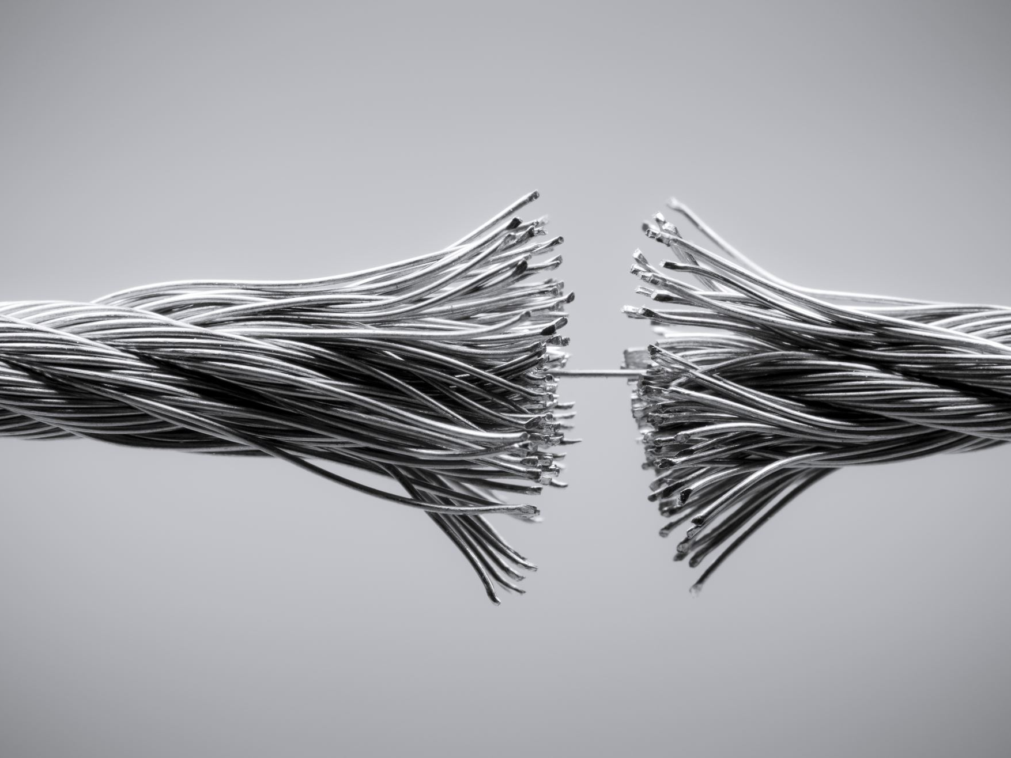
LV POWER & CONTROL CABLES
CONDUCTOR: Copper(Plain/Tinned), Aluminium
INSULATION : XLPE/PVC/HRPVC/LSZH
INNER/OUTER SHEATH: PVC/HRPVC/HDPE/FR/FRLS/LSZH
ARMOUR :
GS Wire/GS Strip/Al Wire/Al Strip/GS Tape/ Al Tape/ATC Braid/SS
Braid/GS Braiding VOLTAGE GRADE Up to 3.3kV
APPLICABLE STANDARDS : IEC-60502-1, BS 6346, BS 5467, BS 6622, IS 1554-1, IS-7098-1/2
PACKING : Wooden/Steel Drums
PRODUCT RANGE :
Conductor Size Up to 1000 sq.mm.,
Power Cables Up to 5 cores
Control Cables - Up to 61 Cores, from 0.5 sq.mm. to 6.0 sq.mm.
*Customized cable design as per project/customer requirement available.
* Cable accessories can be offered (if required).

Slide 7
HV/MV CABLES
APPLICABLE STANDARDS : BS 6622, BS 7870, IEC-60502-2, IS 7098 -2, IEC 60840 IS : 9968 P-2, IS : 14494
VOLTAGE RATING : 3300 to 33000 Volts (For XLPE/RUBBER) Up to 33000 Volts (For RUBBER)
PRODUCT RANGE : Single Core Cables - Up to 1600 sq.mm. Three Core Cables - Up to 400 sq.mm.
CONSTRUCTION DETAILS
CONDUCTOR :
Annealed Bare/ Tinned Copper/Aluminum (Water-blocked conductors available on
request)
TAPE OVER CONDUCTOR (If Required) Semi Conducting Tape Over Conductor
CONDUCTOR SCREEN :
Extruded Semi Conductive Conductor Screen
INSULATION :
XLPE/RUBBER
INSULATION SCREEN - Non - Mettallic : Extruded Semi Conductive Insulation
Screen BEDDING : (if required) Semi Conducting Water Blocking Tape
METALLIC SCREEN : Copper Tape screening Copper Wire screening Metallic Lead Sheath
Corrugated Aluminum or Copper or Steel
INNER SHEATH : (IF APPLICABLE) PVC/LSZH/FRLS PVC /FR PVC/MDPE/ RUBBER
ARMOUR : (IF APPLICABLE) Galvanized Steel Wire/Flat Strip Armor/Aluminum Wire/ Armor/
Tape Armor (Galvanized Steel/Copper/Aluminum)
OUTER SHEATH : PVC/LSZH/FRLS PVC/FR PVC/MDPE/RUBBER
*Customized cable design as per project/customer requirement available.
* Cable accessories can be offered (if required).

Slide 8
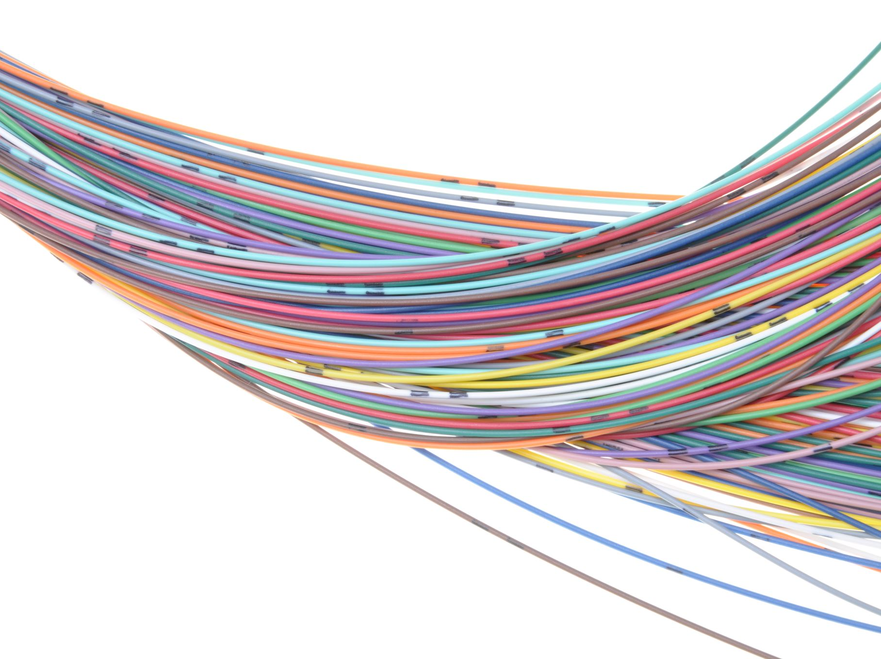
EHV CABLES
EXTRA HIGH VOLTAGE CABLES is under technical collaboration with BRUGG to manufacture EHV cables upto 400kV
APPLICABLE STANDARDS: IEC 60840, IEC-62067, IS 7098 - 3
VOLTAGE RATING 66kV to 400 kV
PRODUCT RANGE EHV Cables - Upto 2500 sqmm
CONSTRUCTION DETAILS
CONDUCTOR : Copper/Aluminium (Stranded Compacted Circular or
Segmented)/ Enameled copper
TAPE OVER CONDUCTOR : Semi Conducting Tape Over Conductor
CONDUCTOR SCREEN : Extruded Semi Conductive Layer
INSULATION : Extruded Super Clean XLPE Layer
INSULATION SCREEN : Extruded Semi Conductive Layer
BEDDING : Semi Conducting Water Blocking Tape
METALLIC SCREEN : Copper Tape/Wire Screening (if required)
BEDDING TAPE : Semi-conducting / Non Conducting Water Blocking
Tape
RADIAL WATER
BARRIER/METALLIC SHEATH :
1. Aluminium/Copper/ Steel Corrugated Sheath
2. Lead Alloy Sheath
3. Poly-AI OUTER SHEATH PVC/HDPE/MDPE/ FRLS PVC/FR PVC/
LSZH SEMI
CONDUCTIVE LAYER : Extruded or Graphite coating
* Customized cable design as per project/customer requirement
available.
* Cable accessories can be offered if required.

Slide 9
SIGNAL & INSTRUMENTATION CABLES
APPLICABLE STANDARDS :
BSEN 50288 PART-7, IEC-60092, PAS 5308
VOLTAGE GRADE : Upto 1100 Volts
PRODUCT RANGE : Multicore/Multi-pair/Multitraid/Signal Instrumentation Cables (Conductor Size Upto 6 sq.mm.)
CONDUCTOR : Tinned/Plain Copper as per BS EN 60228
INSULATION : XLPE /PE/HFFR/EPR/ PVC
SCREENING (INDIVIDUAL PAIR/TRAID SCREENING OR OVERALL SCREENING OR BOTH) : Aluminium Mylar Tape Screening Copper Tape/Wire Screening Tinned Copper Braiding
INNER SHEATH : PVC/PE/HFFR/PCP/CSP/FRLS PVC/FR PVC
ARMOUR : Galvanised Steel Wire/Flat Strip Armour Galvanised Steel Wire Braiding Tape Armour (Galvanised Steel/Copper/ Aluminium)
OUTER SHEATH : PVC/PE/HFFR/PCP/CSP/FRLS PVC/FR PVC
* Customized cable design as per project/customer requirement available.
* Cable accessories can be offered if required.

Slide 10
SOLAR CABLES
APPLICABLE STANDARDS : TUV 2 Pfg 1169/08.07, BSEN 50618, IEC 62930
VOLTAGE RATING : Up to max up to 1.8 KV DC
CERTIFICATION : TUV
CABLE TYPE : PV1-F, H1Z2Z2-K
PRODUCT RANGE : PV Cable ( Single Core) - Up to 400 sqmm
CONSTRUCTION DETAILS CONDUCTOR : Flexible Annealed Tinned Copper (Class 5)
INSULATION : Thermosetting Polyolefine Zero Halogen Compound (XLPO)
OUTER SHEATH : Thermosetting Polyolefine Zero Halogen Compound (XLPO)
PROPERTIES :
• A lifetime ‘Component’: lasts up to 30 years even under tough conditions used in extreme
weather conditions (UV Resistance)
• Halogen-free: low smoke emission and low toxicity during fire
• Flame & fire retardant
• Flexibility & stripability: for fast and easy installation
• Easy installation: with colour identification
• Suitable to common connector types TUV, UL VDE, UTE and IMQ certified
• One common factor for most of the photovoltaic power systems is outdoor use, characterised
by high temperature / high UV radiation
* Customized cable design as per project/customer requirement available.
* Cable accessories can be offered (if required).

Slide 11
RUBBER CABLES
APPLICABLE STANDARDS : IEC-60092, IEC-60502-1&2, BS 7919, BS 6007, BS 7889, BS 6500, IS: 9968/P-1, IS: 9968/P-2, IS:14494, IS:16246
VOLTAGE RATING : Up to 33000 Volts
PRODUCT RANGE : Flexible Cables, Railway Flexible Cables, Trailing Cables, Mining Cables, Festoon Cables Etc.
CONSTRUCTION DETAILS
CONDUCTOR : Tinned/Plain Copper As Per BS - 6360/IEC-
60228, IS:8130
INSULATION : EPR/CSP/SILICON/EVA INNER SHEATH
PCP/CSP/NBR/EVA/CPE ARMOUR (IF REQUIRED)
Galvanised Steel Wire Or Copper Wire Braiding
OUTER SHEATH : PCP/CSP/NBR/EVA/CPE
* Customized cable design as per project/customer requirement available.
* Cable accessories can be offered (if required).

Slide 12
FIRE SURVIVAL CABLES
APPLICABLE STANDARDS : BS 7846, IEC-60502-1, BS EN 50288 PART-7, IEC-60092, IS:16246
VOLTAGE RATING : Up to 1100 Volts
PRODUCT RANGE : LV Power Cables - Conductor Size Upto 400 sq.mm. (For Multicore) & Upto 1000 sq.mm. (For Single Core) LV Control & Instrumentation Cables - Conductor Size Upto 6 sq.mm. (Upto 61 Cores) Signal Cables - Conductor Size Upto 6 sq.mm. (Upto 100 Pairs/Traids)
CONSTRUCTION DETAILS
CONDUCTOR : Tinned/Plain Copper as per BS -6360/IEC-60228, IS:8130 HEAT
BARRIER/FIRE PROOF LAYER Glass Mica Tape Wrapped Over Conductor
INSULATION : XLPE/SILICON RUBBER/EVA/SCP/ HRPVC/LSZH/CSP/EPR
SCREENING (IF REQUIRED) : Aluminium Mylar Tape Screening Copper
Tape/Wire Screening Tinned Copper Braiding
INNER SHEATH : PVC/LSZH/EVA/PCP/CSP/ FRLS PVC/FR PVC
ARMOUR : Galvanised Steel Wire/Flat Strip Armour Galvanised Steel Wire
Braiding Tape Armour (Galvanised Steel/Copper/ Aluminium)
OUTER SHEATH : PVC/LSZH/EVA/PCP/PCP/CSP/FRLS PVC/ FR PVC
* Customized cable design as per project/customer requirement available.
* Cable accessories can be offered (if required).

Slide 13
WINDING WIRES & FLAT CABLES
CONDUCTOR : COPPER
INSULATION : PVC/TRIPLE POLY TAPE
VOLTAGE GRADE : UPTO 1100 V
APPLICATION STANDARD: 1)IS:8783 (Part 4 Section 1) :1995
2)IS:8783 (Part 4 Section 3) : 1995
3)IS: 694
PACKING : COILS/BOX PACKING FOR WINDING WIRES
DRUM PACKING 500 MTRS FOR FLAT CABLES
PRODUCT RANGE : WINDING WIRES :- 0.50 to 3.00 Sq. mm FLAT CABLES: 1.50 to 35 Sq. mm
PRODUCT APPLICATION : MOSTLY IN SUBMERSIBLE PUMPS & MOTORS

Slide 14
COMMUNICATION CABLES
CAT 6 Cable
Conductor : Bare Conductor Insulation : HDPE
Sheath : PVC (Flexible Cable)
Sheath Colour - Grey & Yellow Standard : ANSI/TIA-568-C.2 Packaging : 305 mtrs
Telephone Cable
Conductor : Bare Conductor
Insulation : HDPE
Sheath : PVC
Sheath Colour - Grey
Standard : ITD
Packaging : 100/90 mtrs
Range : 1 pair, 2 pair, 3 pair, 4 pair, 5 pair, 10 pair
Size : 0.40 & 0.50 mm
Co-axial Cable
Conductor : Bare Conductor and CCS
Insulation : Foam PE
Sheath : PVC
Sheath Colour - Black
Shielding : AL – Myler Tape Aluminium Wire Braid & Jelly Filled
Packaging : Coil & Drum 100 mtrs/ 305 mtrs
Range : RG 11, RG 59, RG 6
CCTV Cables
Conductor : Bare Conductor Insulation : Physical Foam PE / PE
Standard : ANSI/TIA-568-C.2
Sheath colour
Overall Sheath : PVC (White)
Shield (Co-Axial): Bonded Aluminium tape & Aluminium Alloy Braid
Types (Range) : CCTV 4+1, CCTV 3+1
Packaging: 90/100/180 mtrs

Slide 15
EV CABLES Charging cables for electric vehicles
APPLICABLE STANDARDS : BS EN 50620:2017
VOLTAGE RATING : Up to 300/500 & 450/750 Volts
CODE DESIGNATION : H05BZ5-F or H05BZ6-F or H07BZ5-F or H07BZ6-F
PRODUCT RANGE: 300/500 V - 1,5 mm2 and 2,5 mm2 450/750 V - 1,5 mm2 3C and 2,5 mm2 to 35mm2 – 3,4 and 5 core. CC/CP cores- 0,5 mm2 and 1,0 mm2- number of cores not specified
CONSTRUCTION DETAILS
CONDUCTOR : Annealed Bare OR Tinned Copper
Class5 TAPE OVER CONDUCTOR (If Required)
INSULATION : Extruded Halogen free EVI-2
INTERSTITIAL FILLERS : Fillers shall be composed of one of the following or of any combination
of the following: a compound based on polymeric materials; or natural or synthetic textiles; or paper.
OUTER SHEATH : Extruded Halogen free EVM-1 (Z5) OR EVM-2 (Z6)
COLOUR SCHEME 3 core cable: green-and-yellow, blue, brown
4 Core cable: green-and-yellow, brown, black, grey
5 core cable: green-and-yellow, blue, brown, black, grey.
The colors of pilot and/or control cores shall be clearly identified and different to the
power cores.
* Customized cable design as per project/customer requirement available.

Slide 16
Cable Accessories CABLE GLAND
TYPES : -SINGLE COMPRESSION MEDIUM DUTY CABLE GLANDS ( MEDIUM / HEAVY)
-DOUBLE COMPRESSION MEDIUM DUTY CABLE GLANDS ( WEATHER PROOF / FLAME PROOF)
- FLANGE TYPE CABLE GLANDS
-DOUBLE COMPRESSION BRASS CABLE GLAND FOR UNARMORED CABLES WEATHERPROOF
- CRIMPING TOOLS
- PG GLANDS
*BW, CW, A1/A2, Aluminium, Stainless Steel & other Cable Glands are available on request.

Slide 17
LUGS
COPPER SHEET METAL TERMINAL ( RING , PIN, FORK $ U-TYPE)
( NON-INSULATED , INSULATED & METAL REINFORCEMENT)
COPPER TUBULAR LUGS TERMINALS & IN LINE CONNECTORS
( END SEALING FERRULES & SEALING FERRULES )
COPPER REDUCER
ALLUMINIUM TUBULAR LUG TERMINAL ENDS , IN LINE CONNECTOR & REDUCER

Slide 18
Switch & accessories
WIDE RANGE OF SWITCHES , REGULATOR , SOCKETS & PLATES ( MODULAR AND NON – MODULAR)
MODULAR BOXES ( METAL & PVC BOXES)
ROTARY SWITCHES

Slide 19
Switchgears & ACCESSORIES
TYPES - Miniature circuit breaker (MCB)
- Residual Current Circuit Breaker (RCCB)
- Molded Case Circuit Breaker (MCCB)
- earth-leakage circuit breaker ( ELCB)
- POWER CONTACTOR
- Automatic Changeover with Current Limiter ( ACCL)
- DISTRIBUTION & JUCTION BOXES
( AVAILABLE IN WIDE RANGE )

Slide 20
Lighting solution
Panel lights
TYPES: -Rimless Surface
-Surface Radar
-Rimless Surface
-Step Panel
- Base Light
SHAPE : SQUARE , ROUND
BODY COLOUR : WHITE
COLOUR : 3000K(WARM WHITE) , 4000K( NATURAL
WHITE) AND 6000K ( COOL WHITE)
wattage : 3W , 5W , 10W, 12W , 15W , 20W , 36W

Slide 21
BULB
TYPES: -LED NIGHT LAMP
- LED EMERGENCY LAMP
- LED BULB
- LED HIGH WATTAGE BULB
- LED COLOUR BULB
BODY COLOUR : WHITE
COLOUR : 3000K(WARM WHITE) AND 6000K
(COOL WHITE)
WATTAGE : 3W , 7W , 9W , 15W , 18W , 23W ,
30W , 40W , 50W , 70W

Slide 22
BATTEN
TYPES: -LED BATTEN
- LED TRI COLOUR COLOUR
- LED RADAR BATTEN
- LED ALUMINIUM BATTEN
BODY COLOUR : WHITE
COLOUR : 3000K(WARM WHITE) , 4000K( NATURAL
WHITE) AND 6000K ( COOL WHITE)
VARIENT : 5W , 10W , 20W , 24W , 36W , 40W ,
50W , 70W

Slide 23
DOWN & SPOT LIGHT
TYPES: - COB DOWN LIGHT
- DEEP DOWN LIGHT
- DEEP JUNCTION LIGHT
- LED MINI SURFACE DOWN LIGHT
- ADJUSTABLE DOWNLIGHT
- MODULAR SURFACE
- MINI SURFACE DOWNLIGHT
- SURFACE & TRACK SPOT LIGGHT
SHAPE : SQUARE , ROUND
BODY COLOUR : WHITE
COLOUR : 3000K(WARM WHITE) , 4000K( NATURAL
WHITE) AND 6000K ( COOL WHITE)
VARIENT : 3W ,5W, 8W,10W, 12W , 15W , 20W , 36W

Slide 24
OUTDOORS LIGHT
TYPES : -FLOOD LIGHT
- ALUMINIUM STREET LIGHT
- PVC STREET LIGHT
- SENSOR STREET LIGHT
-STEP LIGHT
WATTAGE: - 20W, 30W, 40W ,50W, 60W , 75W, 100W, 150W , 200W
COLOUR: - 3000K ( WARM LIGHT) , 6500K ( COOL WHITE)

Slide 25
DECORATIVE LIGHT
TYPE : - ROPE LIGHT
- RGB STRIP / STRIP LIGHT
- STRING LIGHT
- WALL LIGHT ( 6W , 12w)
- Heritage light

Slide 26
Why Buyers Choose Us
No quality variation between samples & bulk
Strong pricing advantage
Quick response & clear communication
Long-term supply capability

Slide 27
Close with Confidence
Share your BOQ or requirement
Get quotation in 24–48 hours
Build a long-term sourcing partnership

